Slide 1

Beyond Error
Why Ensembles Work — Until They Don't…
Yash Gawankar, Athena Lobo
Machine Learning · CSCI-567

Slide 2
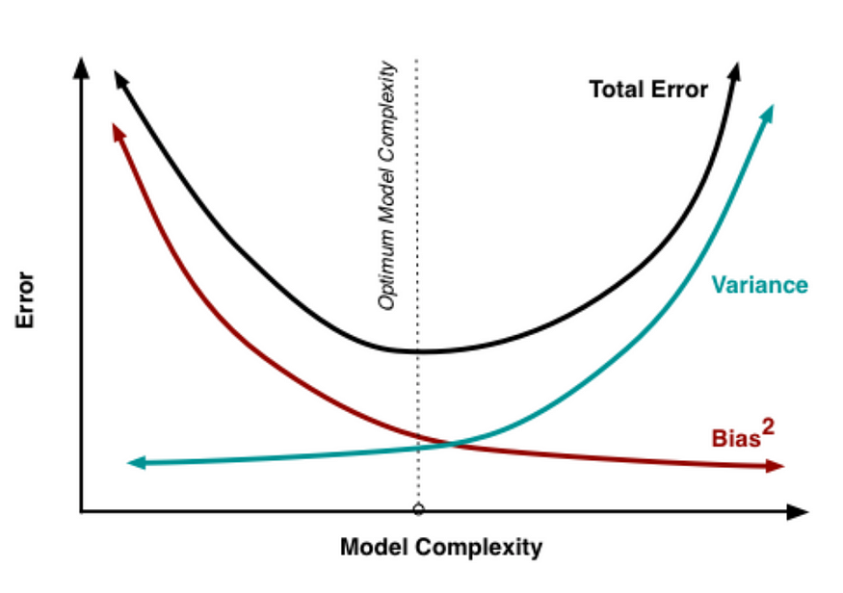
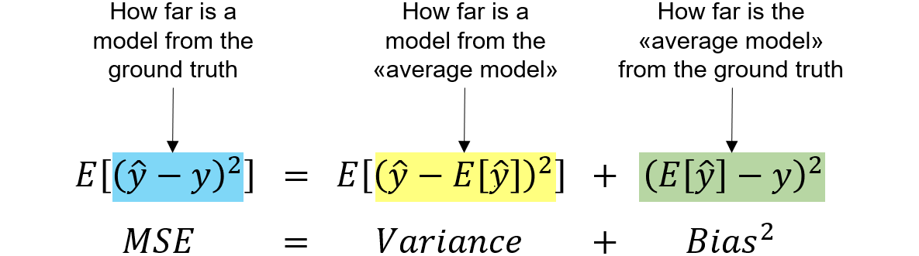
Motivation: Error is a sum. But which part moved?
MSE
Decomposed
267
→
Variance
Black box
Bias²
Bagging reduces variance — Error goes down
Boosting reduces bias — Error goes down
Same number, completely different story underneath

Slide 3
Research Questions
1
How do bagging and boosting trace distinct trajectories in Bias²–Variance space as we vary params?
3
Can Covar(f_bag, f_boost) predict when convex mixtures will improve total error?
2
Do hybrid constructions interpolate between their parents, or can they reach strictly better bias-variance trade offs?
4
Does diversity stay reliable under noise? Or does noise-induced disagreement become a misleading signal?
Prior Work
Bias- Variance Decomposition
Bagging (Variance ↓)
Boosting (Bias ↓)
Covariance & Ensembles
Diversity & Modern Theory
Geman et al. 1992 [1]
Breiman 1996 [2]
Friedman 2001 [3]
Ueda & Nakano 1996 [4]
Brown et al. (2005) [5], Wood et al. (2023) [6]
Error = Bias² + Var + σ²
→
Bagging averages unstable learners
→
Sequential fitting reduces bias via additive modeling
→
Ensemble error depends on covariance between models
→
Diversity ↔ variance reduction, unified perspective
✘ Static view — no notion of how models move in this space
✘ No empirical study of mixtures or optimal weighting
✘ No analysis of bias–variance trajectories across conditions
✘ Limited understanding of variance growth trajectory
✘ No study of when diversity fails (noise regimes)
[1] Geman, S., Bienenstock, E., & Doursat, R. (1992). Neural networks and the bias/variance dilemma. Neural computation, 4(1), 1-58.
[2] Breiman, L. (1996). Bagging predictors. Machine learning, 24(2), 123-140.
[3] Friedman, J. H. (2001). Greedy function approximation: a gradient boosting machine. Annals of statistics, 1189-1232.
[4] Ueda, N., & Nakano, R. (1996, June). Generalization error of ensemble estimators. In Proceedings of International Conference on Neural Networks (ICNN'96) (Vol. 1, pp. 90-95). IEEE.
[5] Brown, G., Wyatt, J. L., Tino, P. (2005). Managing diversity in regression ensembles. Journal of machine learning research, 6(9).
[6] Wood, D., Mu, T., Webb, A. M., Reeve, H. W., Lujan, M., & Brown, G. (2023). A unified theory of diversity in ensemble learning. Journal of machine learning research, 24(359), 1-49.

Slide 4
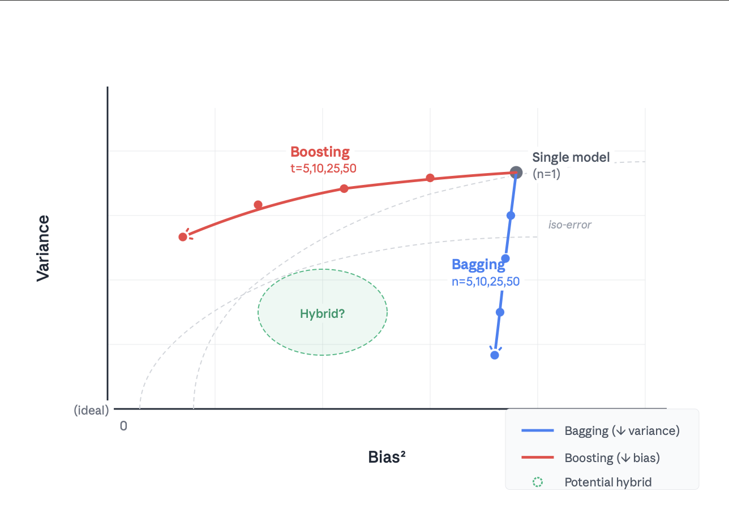
Approach
Framework
Regression under squared loss → exact bias-variance decomposition
Empirical estimation via repeated bootstrap resampling
Each configuration = one point in Bias²–Variance space
Varying certain parameters would trace a trajectory
Methods
Bagging: Random Forest
Boosting: XGBoost
Hybrids:
Architectural: BaggingRegressor wrapping XGBoost
Convex combination: f_{λ} = λ·f_{boost} + (1−λ)·f_{bag}

Slide 5
Experiments & Datasets
What we vary
Dataset noise level
Training set size
Base learner complexity
Ensemble size
What we measure
Bias² and Variance trajectories
Diversity = individual var − ensemble var
Covariance between parents → predicts hybrid
Datasets
Synthetic
California Housing
make_regression + sinusoidal — controlled, theory-comparable
~20k samples — real noise, real interactions

Slide 6
Plan & Milestones
Before Pre-Final Check-in
Before Final Submission
1. Bias–Variance–Covariance Estimation
Real-Data Validation
Bootstrap resampling (M ≈ 50) → estimate Bias², Variance, Cov(f_bag, f_boost)
California Housing dataset
Test pattern generalization
2. Synthetic Experiments
Vary: noise level · training size · model complexity · ensemble size
Synthesis of Insights
3. Trajectory Atlas
(core contribution)
• Bias vs variance improvements
• When hybrids outperform
• When diversity misleads
Map Bias²–Variance trajectories for RF, XGBoost, and hybrid models
4. Convex Mixture Analysis
f_λ = λ·f_boost + (1−λ)·f_bag
Theory: derive λ* from Bias, Var, Cov
Empirics: sweep λ ∈ [0,1], compare predicted vs actual λ*
Final Deliverables
☐ Complete trajectory atlas
☐ Theory ↔ empirical validation
☐ Final report + presentation
5. Diversity & Covariance Analysis
• Does Cov(f_bag, f_boost) predict hybrid gains?
• When does diversity fail under noise?
Key question: When does combining models outperform both parents?

